Slide 1

Intelligent optimization algorithm Week 05_ Introduction

Slide 2
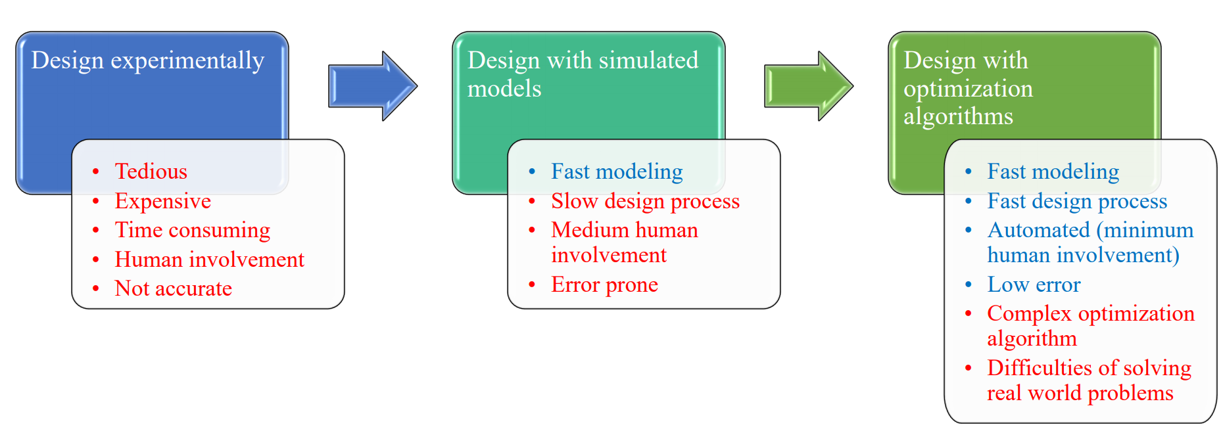
History of Optimization Techniques

Slide 3
Outline (目录)
Optimization problem
Single objective optimization problem
Stochastic optimization algorithms
Constrained optimization algorithms
Multi-objective optimization problems
2/16

Slide 4
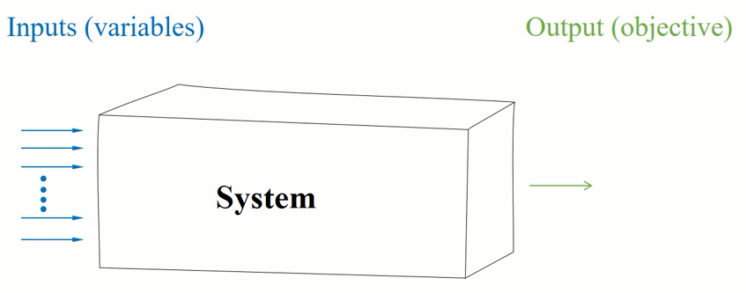
Optimization problem
01
Single object problem
4/16

Slide 5
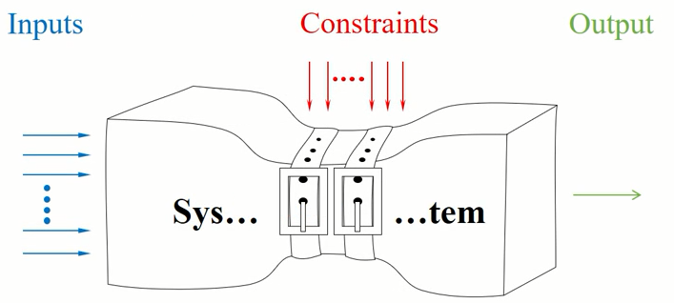
Optimization problem
01
Single object problem with constraints
4/16

Slide 6
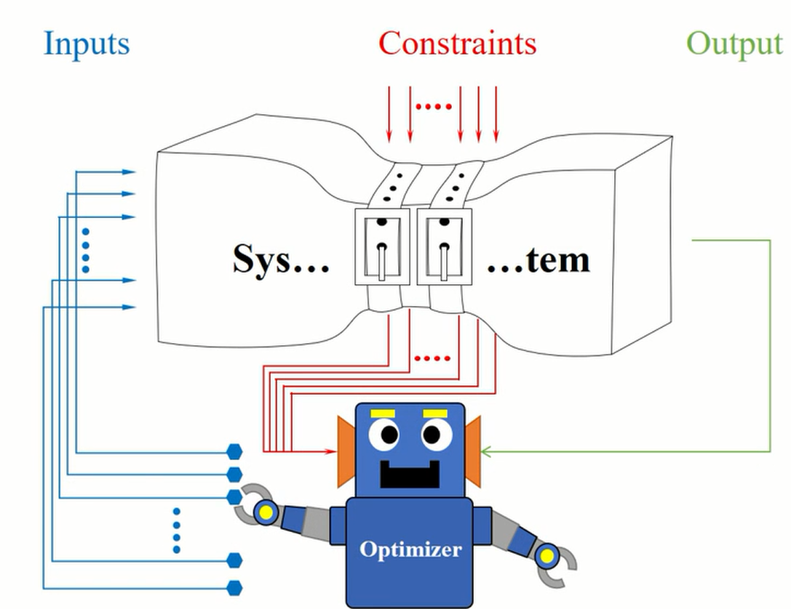
Optimization problem
01
Optimization algorithm
Brute force search
5/16

Slide 7
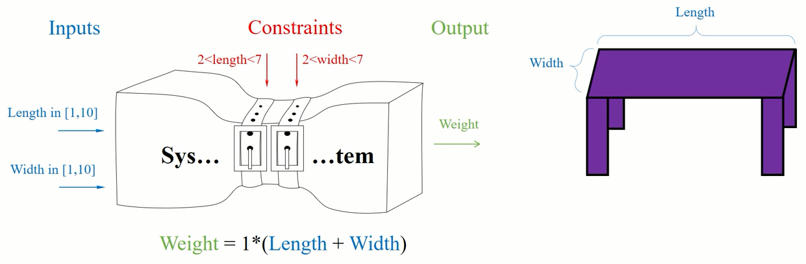
Optimization problem
01
Example: Design a table
The objective is to minimize the weight
5/16

Slide 8
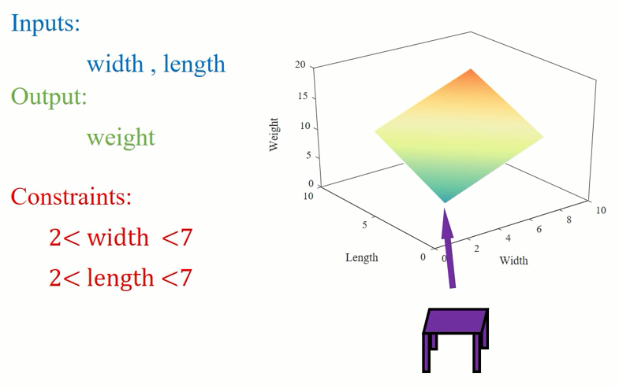
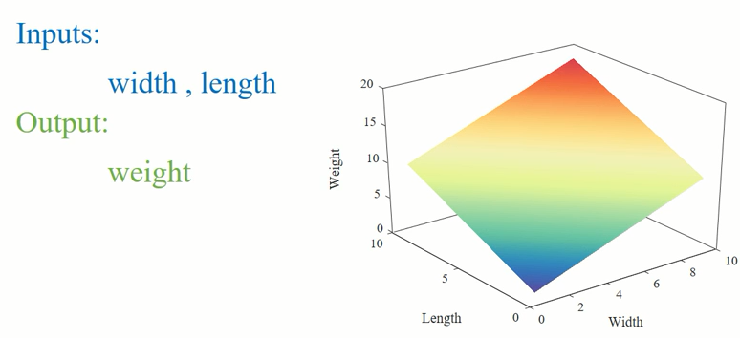
Optimization problem
01
Search space of the table problem ---Unimodal
No local solution, only global solution
The objective is to minimize the weight
5/16

Slide 9
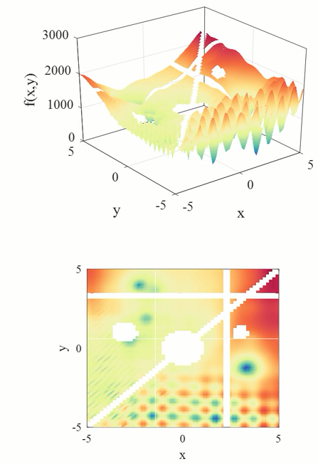
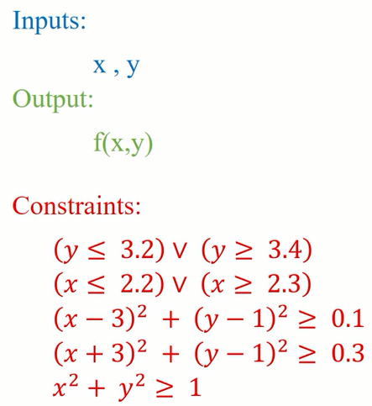
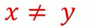
Optimization problem
01
Search space of the table problem ---Multi-modal
Both local solutions and global solutions
5/16

Slide 10
Optimization problem
01
Difficulties of a real-word proble
A large number of local solutions
A large number of constraints
Discrete variables
Deceptive search space
Multiple objectives
Dynamically changing
Uncertainties in inputs, outputs, or constraints
Etc.
5/16

Slide 11
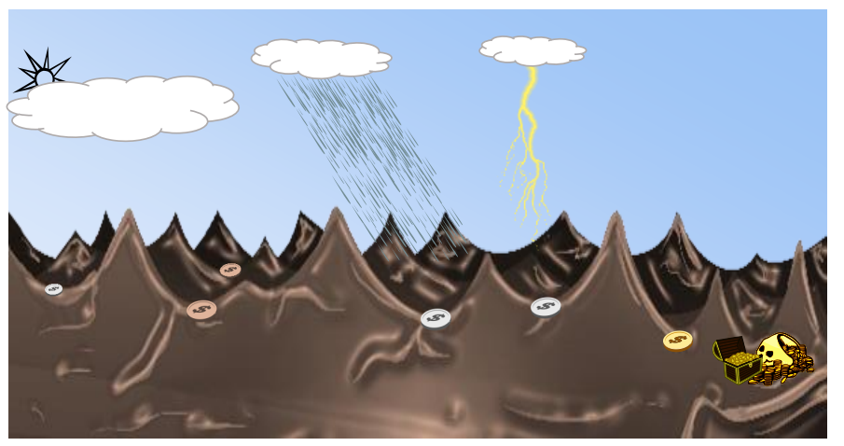

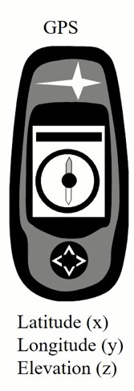
Single objective optimization problem
02
Analogy
Somewhere at
deepest valley
Mountainous area with a giant hidden treasure
7/16

Slide 12
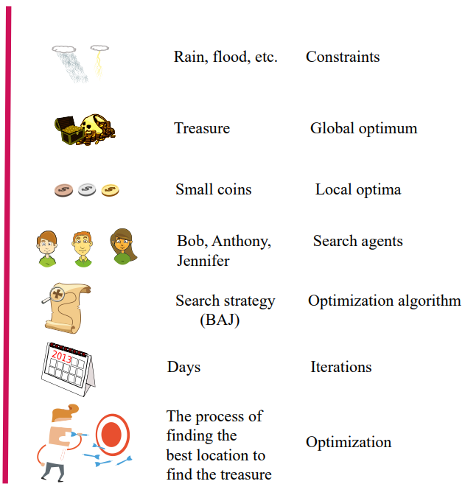
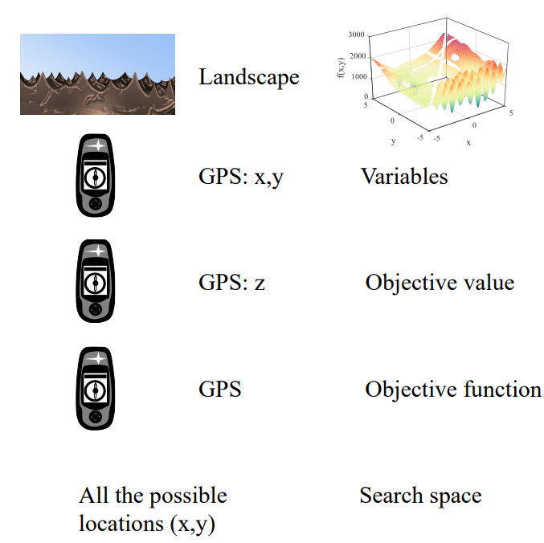
Single objective optimization problem
02
Analogy

Slide 13
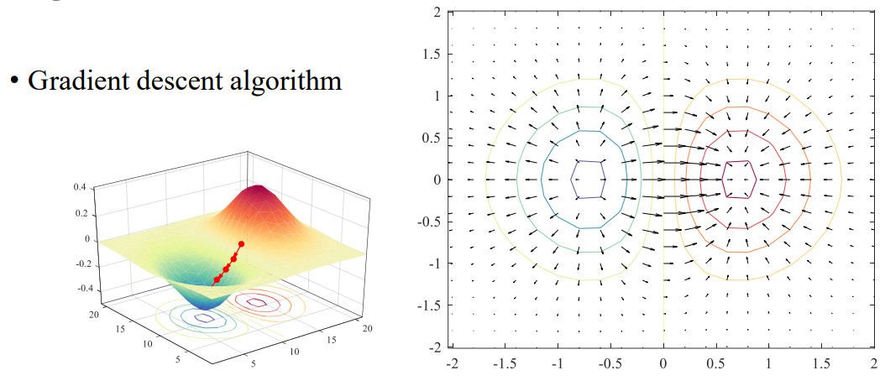
Single objective optimization problem
02
Conventional (deterministic) optimization algorithms

Slide 14
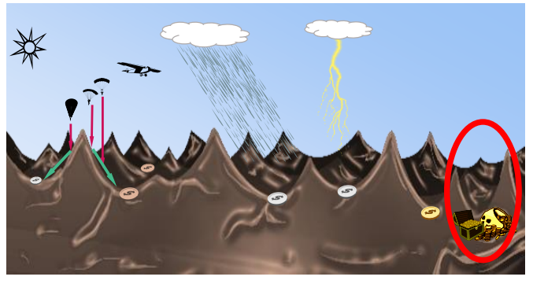
Single objective optimization problem
02
Conventional (deterministic) optimization algorithms
Find two small treasures based on the gradient descent algorithm

Slide 15
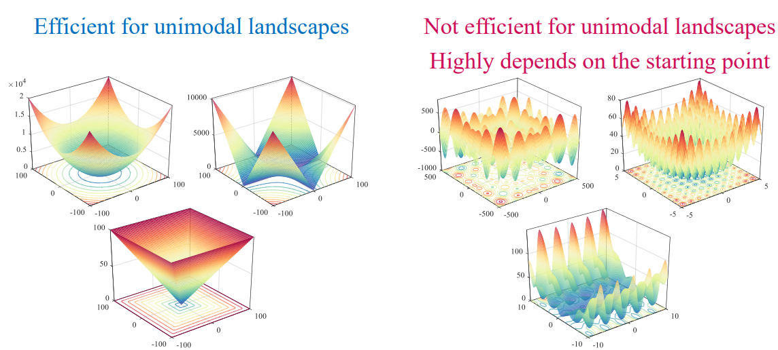
Single objective optimization problem
02
Gradient descent algorithm
Local optimization stagnation,
local optimial entrapment,
or even premature convergence

Slide 16
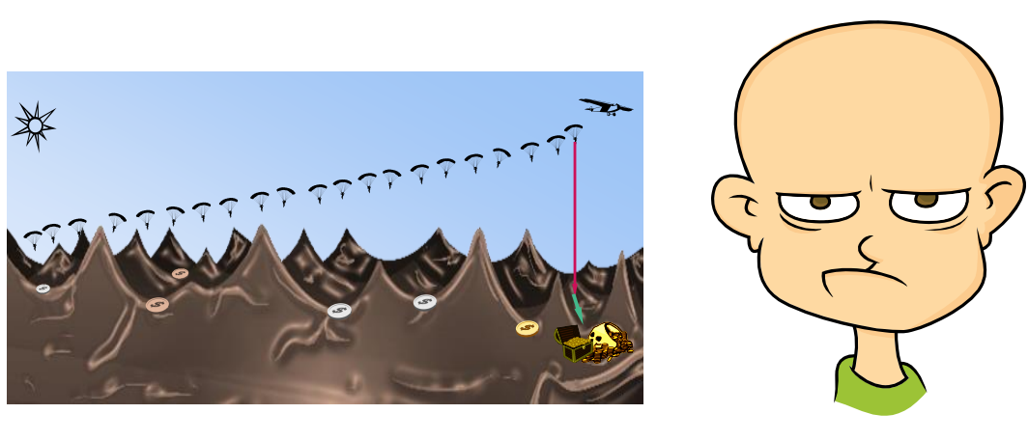
Single objective optimization problem
02
Gradient descent algorithm

Slide 17
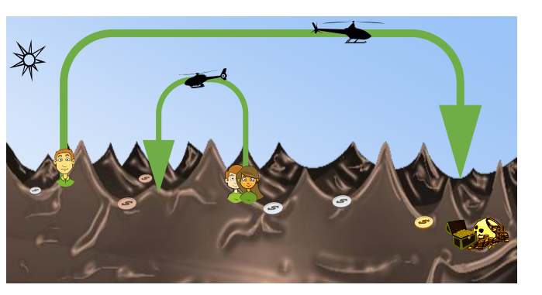
Single objective optimization problem
02
Modern (stochastic) optimization algorithms

Slide 18

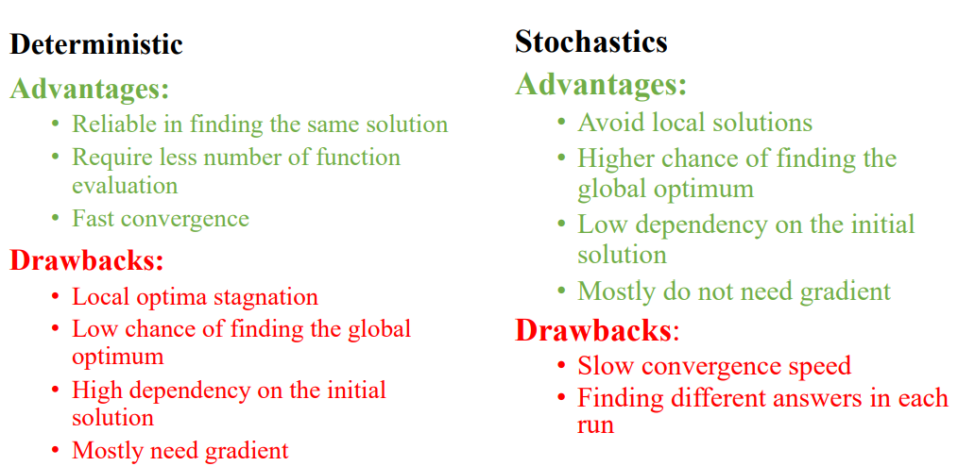

Single objective optimization problem
02
Modern (stochastic) optimization algorithms

Slide 19
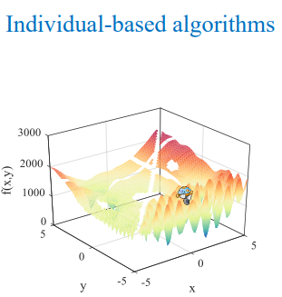
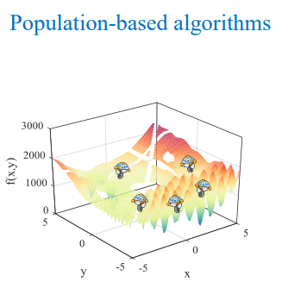
Stochastic optimization algorithms
03
Classification of stochastic optimization algorithms
3/16

Slide 20
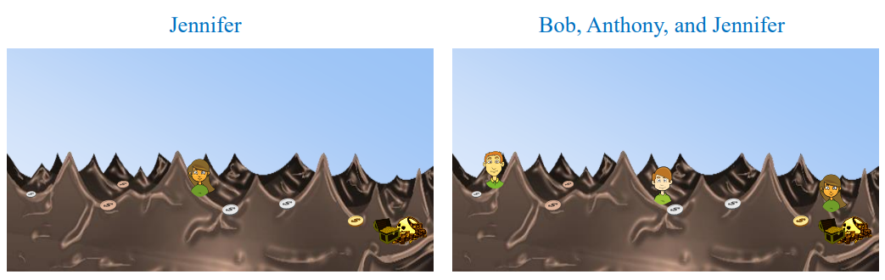
Stochastic optimization algorithms
03
Classification of stochastic optimization algorithms
3/16

Slide 21
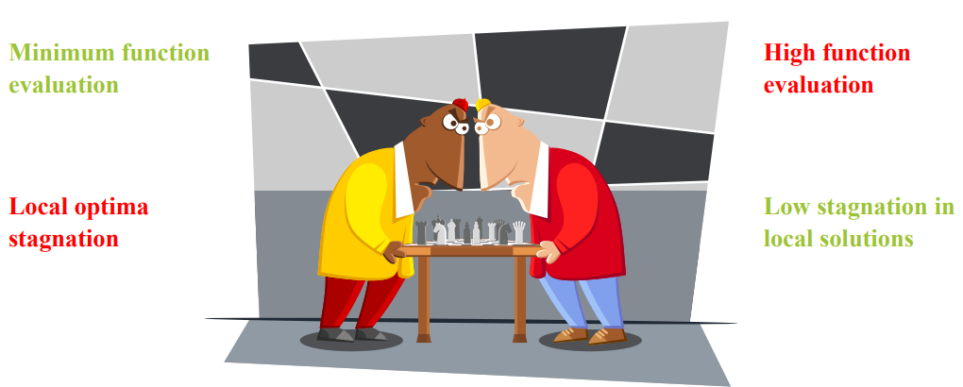
Stochastic optimization algorithms
03
Individual-based vs. Population-based
3/16

Slide 22


Stochastic optimization algorithms
03
Population-based
High exploration
High local optima avoidance
3/16

Slide 23


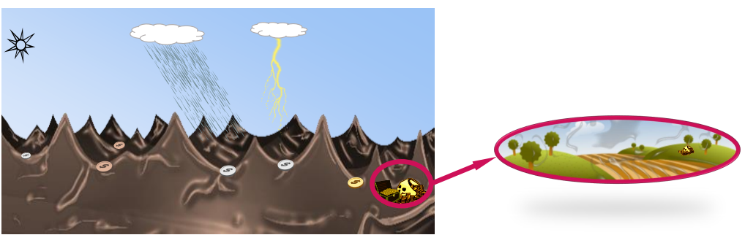
Stochastic optimization algorithms
03
Exploration vs. Exploitation
3/16

Slide 24
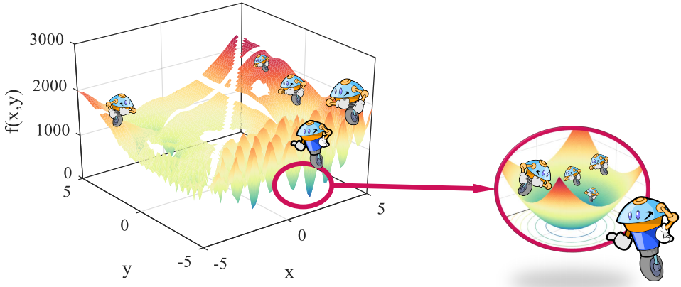
Stochastic optimization algorithms
03
Exploration vs. Exploitation in populationbased algorithms
3/16

Slide 25
Stochastic optimization algorithms
03
Classification of population-based algorithms
Population-based algorithms
Evolutionary algorithms
Physics-based algorithms
Swarm-based algorithms
GA
DE
GSA
CSS
PSO
GWO
ES
GP
CFO
BBBC
ACO
ABS
3/16

Slide 26
Stochastic optimization algorithms
03
粒子群算法（ Particle swarm optimization, PSO）源于对鸟群捕食行为的研究，模拟鸟群飞行觅食的行为
灰狼算法（Gray wolf optimization, GWO ）源于对狼群捕食行为的研究
差分进化算法
遗传基因算法
模拟退火算法（Simulated annealing，SA）三种模拟退火流派: Fast, Boltzmann, Cauchy
人工鱼群算法（Artificial fish swarm algorithm, AFSA）
3/16

Slide 27
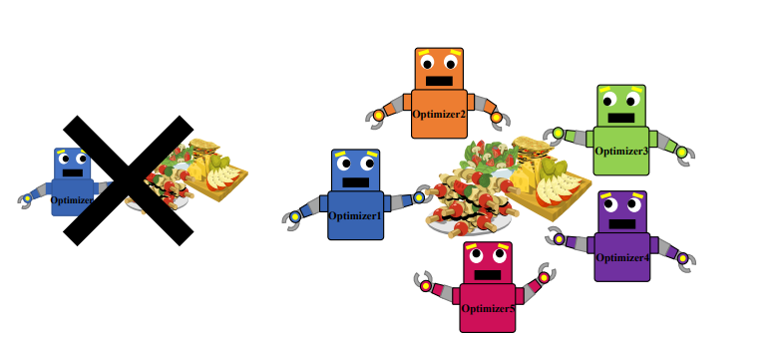
Stochastic optimization algorithms
03
There is no optimization algorithm to solve all optimization problems
3/16

Slide 28
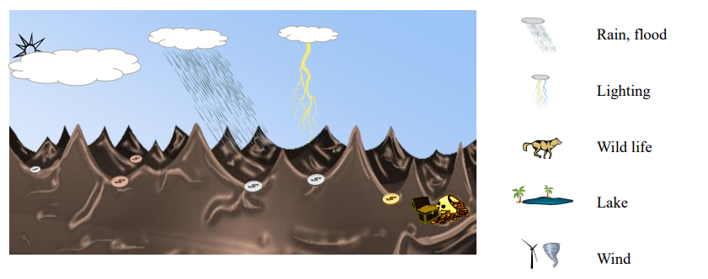
Constrained optimization algorithms
04
Constraints in our analogy
3/16

Slide 29
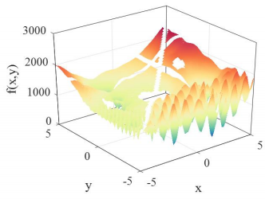
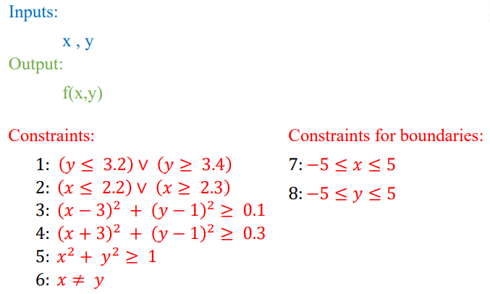
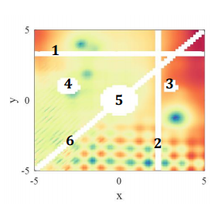
Constrained optimization algorithms
04
Constraints in a landscape
3/16

Slide 30
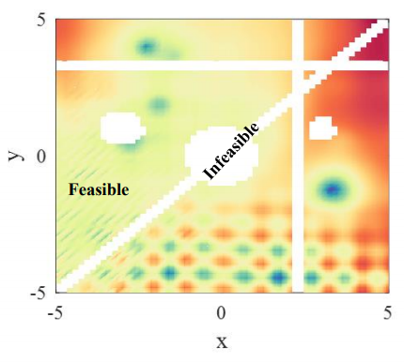
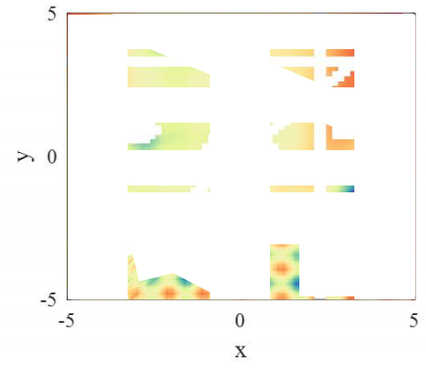
Constrained optimization algorithms
04
Constraints in a landscape
Highly constrained landscapes
3/16

Slide 31
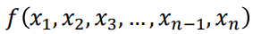
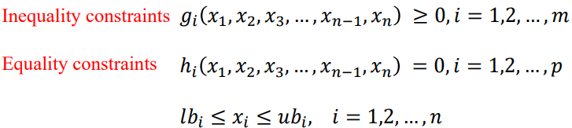
Constrained optimization algorithms
04
Problem formulation with constraints
𝑀𝑖𝑛𝑖𝑚𝑖𝑧𝑒:
𝑆𝑢𝑏𝑗𝑒𝑐𝑡 𝑡𝑜:
3/16

Slide 32
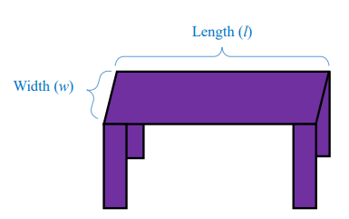
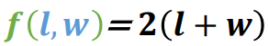
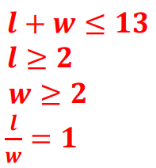
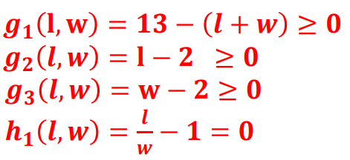
Constrained optimization algorithms
04
Constraints in designing a table
𝑀𝑖𝑛𝑖𝑚𝑖𝑧𝑒:
𝑆𝑢𝑏𝑗𝑒𝑐𝑡 𝑡𝑜:
3/16

Slide 33
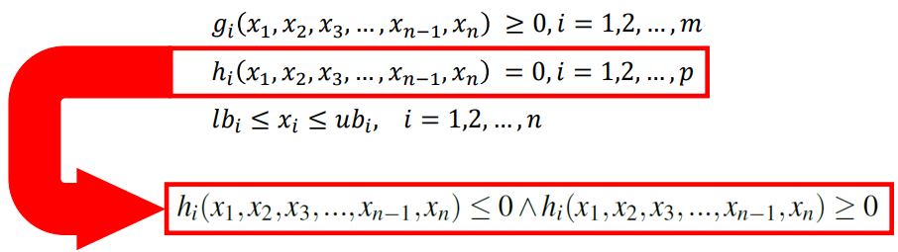
Constrained optimization algorithms
04
Problem formulation with constraints
𝑀𝑖𝑛𝑖𝑚𝑖𝑧𝑒:
𝑆𝑢𝑏𝑗𝑒𝑐𝑡 𝑡𝑜:
3/16

Slide 34
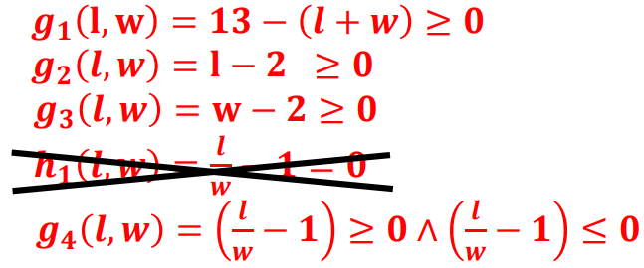
Constrained optimization algorithms
04
Constraints in designing a table
𝑀𝑖𝑛𝑖𝑚𝑖𝑧𝑒:
𝑆𝑢𝑏𝑗𝑒𝑐𝑡 𝑡𝑜:
3/16

Slide 35

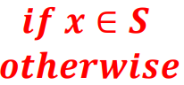
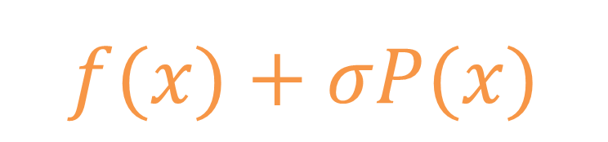
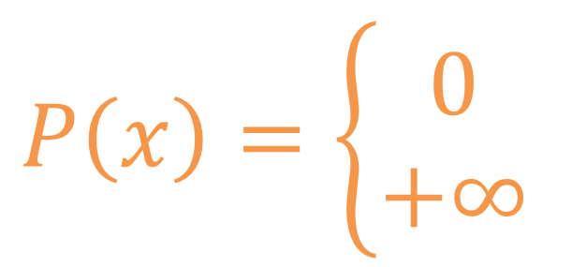
Constrained optimization algorithms
04
Penalty methods
𝑀𝑖𝑛𝑖𝑚𝑖𝑧𝑒:
$$f(x)+σP(x)$$
where:
$$P\left(x\right)=\left\{\begin{aligned}0 \\ +∞\end{aligned}\right.$$
3/16

Slide 36
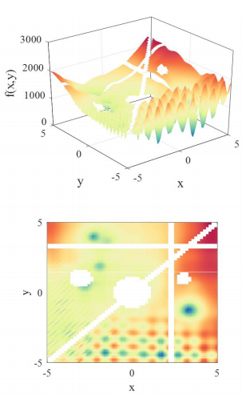
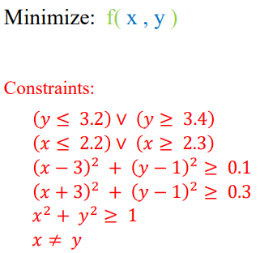
Constrained optimization algorithms
04
Penalty function
3/16

Slide 37
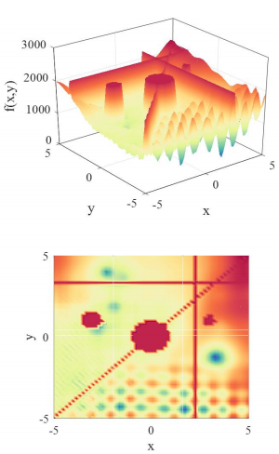
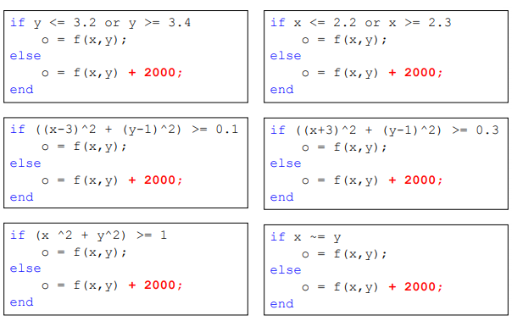
Constrained optimization algorithms
04
Penalty function
3/16

Slide 38
Multi-objective optimization problems
04
To be continued
3/16

Slide 39



This program is writing for Ansys HFSS software. It possesses three parts including the basic software operations, advanced data post-process, and optimization algorithms. Maybe it will also have some GUI design and others.
This is the third part --- optimization algorithms, which mainly includes the basic data input and output funcitions and normal optimization algorithms (PSO, GA, GWO and others) . To make it easier to use these algorithms, there are examples for optimization.
Hope you will have a pleasant experience!
The program starts from 18th NOV. 2020 at City University of HK. Here we have a group of partners (Chen Yang, Ting Li, Zhiyi Zhang, and Zhili Su) with the guidance of Dr. Lu Kai, Hope we can complete this huge project. Best regards to us. If you have any questions, please email to Chen.Yang@my.cityu.edu.hk
Created on Wed Jan 20 01:30:11 2021

